Slide 1

Creating a Chatbot for Wikipedia Articles
Final Year Project
Alex Turner

Slide 2
The Project
Developing a conversational chatbot for a user to ask questions about Wikipedia articles
E.g.:
The chatbot will answer factoid questions based on data drawn from Wikipedia
The chatbot will using machine learning to self-improve based on user’s feedback.
If the user gets a response that was not what they expect, they can indicate this and the chatbot can adjust the probability of that response accordingly
Q: “Where was Alan Turing born?”
A: “Alan Turing was born in Maida Vale, London”

Slide 3
Aims and Objectives
Aim
Develop a chatbot which answers factoid questions based on Wikipedia articles as its dataset, and adapt automatically to user feedback for incorrect responses
Objectives
Investigate conversational chatbots and their use cases
Compare machine learning techniques for training chatbots
Implement a chat bot which answers user questions about Wikipedia articles and adapts to user feedback automatically
Evaluate implementation by testing with a user base and analysing effectiveness of the chatbot
Recommend future improvements and generalise the chatbot to be able to learn from any dataset

Slide 4

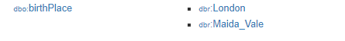
Data and Processing
Data will be drawn from DBpedia (https://wiki.dbpedia.org/)
DBpedia is an open dataset which structures Wikipedia data into meaningful ontologies so that the data is easier to process
From the DBpedia ‘Alan Turing’ record
This makes it easy to find the correct data for the user’s query
The dataset is large, consisting of 4.58 million things, including 1,445,000 persons and 735,000 places
Querying the database can be done via a SPARQL query endpoint

Slide 5
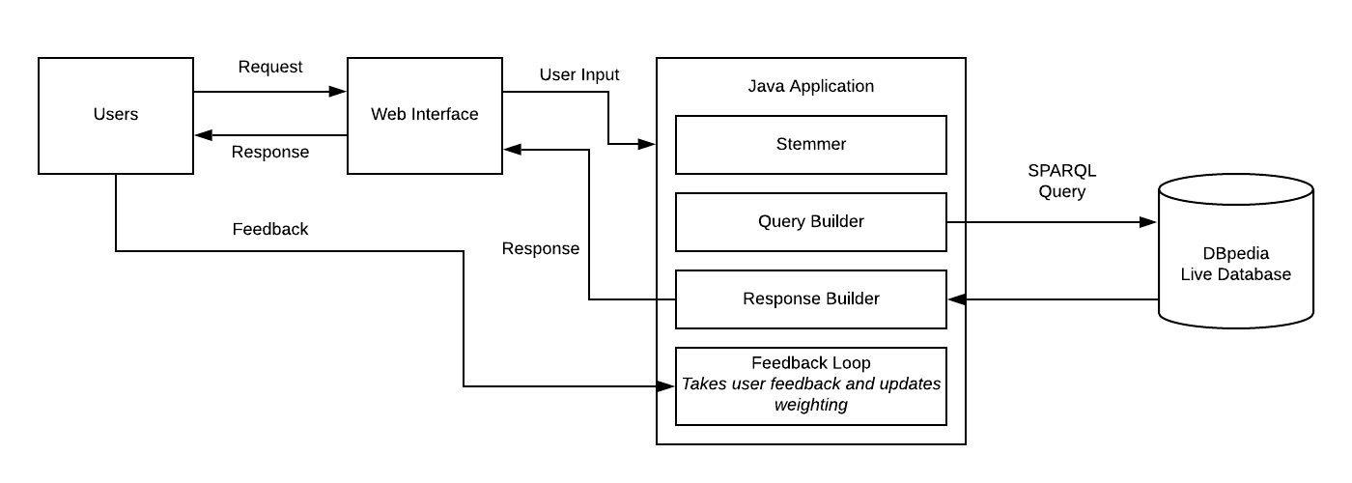
Design

Slide 6
Demo
Demo

Slide 7
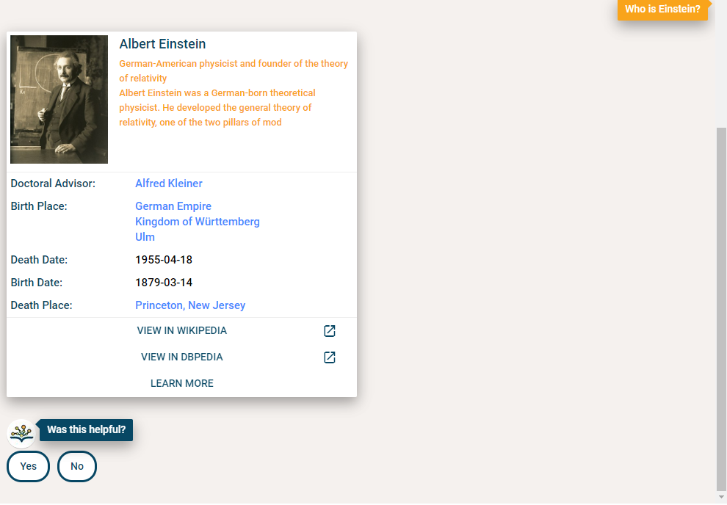
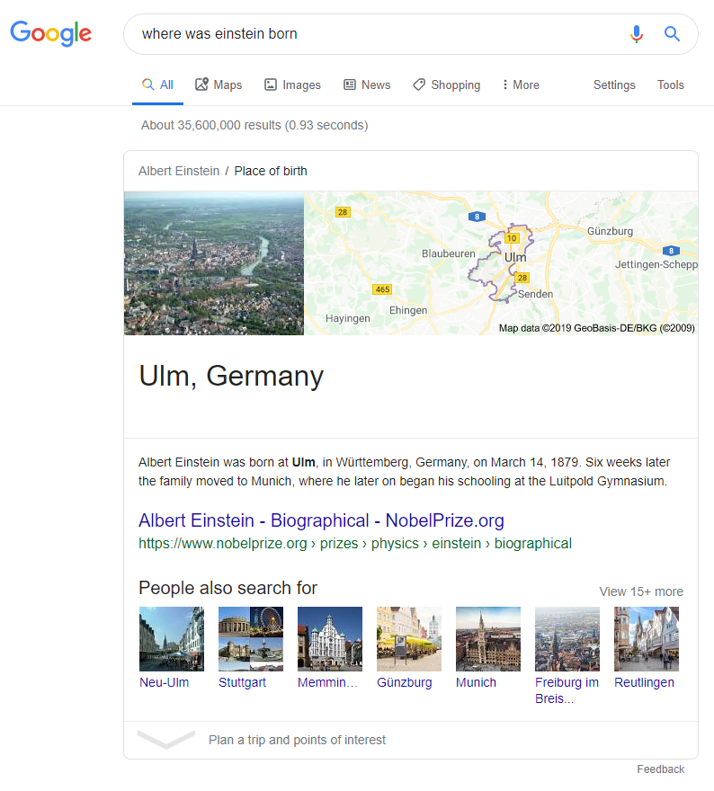
Research
Current Solutions
DBPedia Chatbot
Not properly implemented – only answers a couple of sample questions
Google Assistant / Google Search
Very effective but very broad
Closed source
Implementation
Java with AIML - Artificial Intelligence Modelling Language
Scalable, many effective libraries for chatbots e.g. Program AB

Slide 8
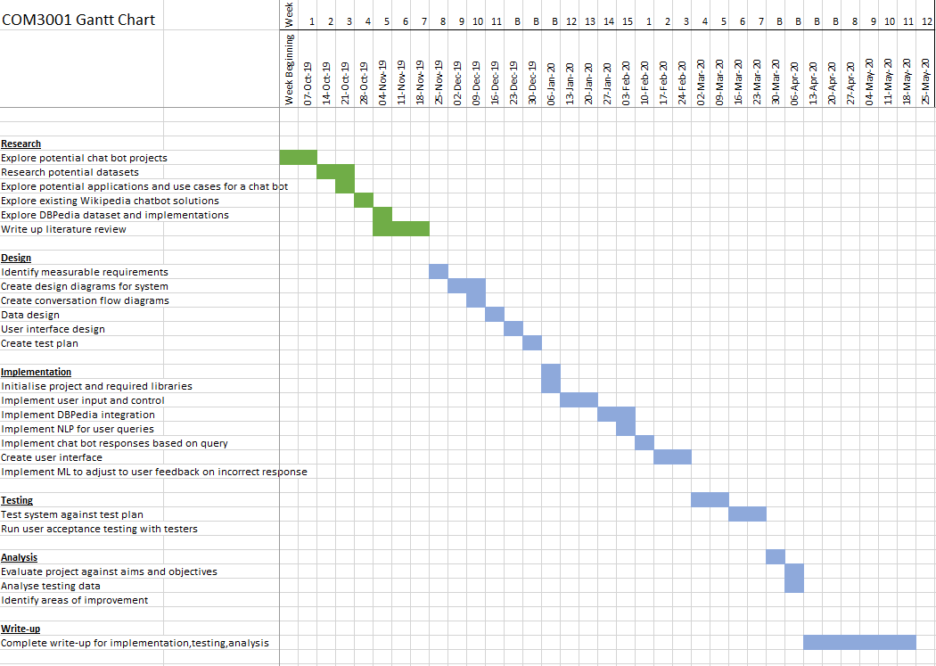
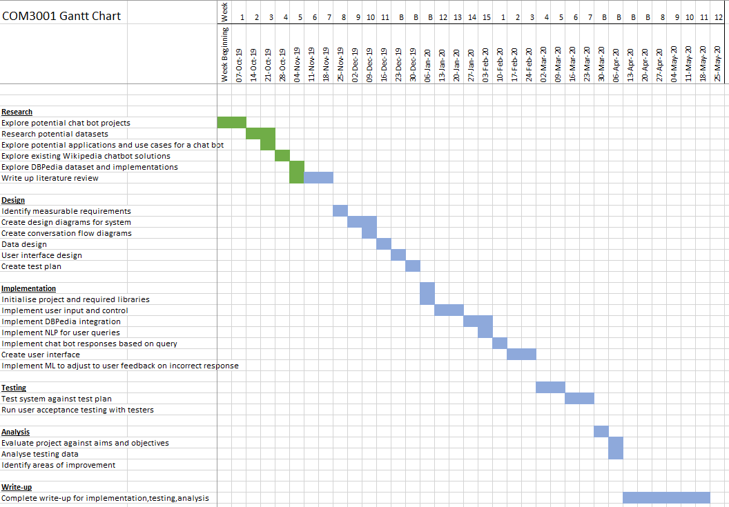
Project Plan

Slide 9

Any Questions?

